Slide 1


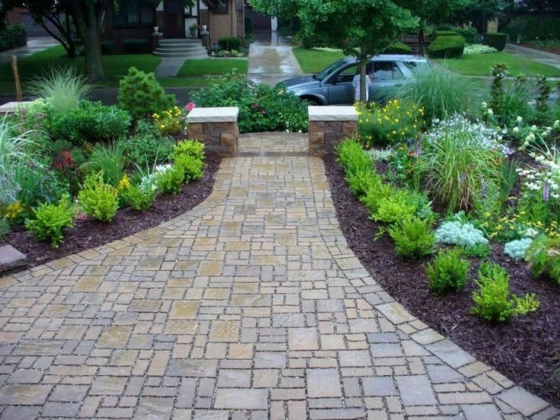
ECO-FRIENDLY & DURABLE: THE BENEFITS OF PERMEABLE CONCRETE PAVERS
Sustainable Solutions for Modern Infrastructure

Slide 2

01
INTRODUCTION TO PERMEABLE CONCRETE PAVERS
05
What Are Permeable Concrete Pavers?
06
Specially designed pavers that allow water to pass through them.
Help reduce water runoff and promote natural groundwater recharge.
Used in driveways, sidewalks, patios, and parking lots.
Why Are They Important?
Growing concerns over urban flooding and environmental sustainability.
Need for durable and eco-friendly paving solutions.

Slide 3

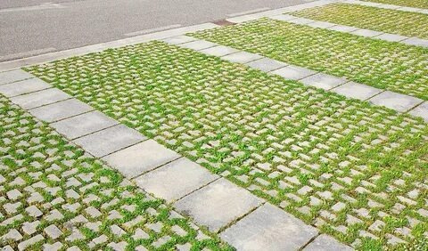
ECO-FRIENDLY BENEFITS OF PERMEABLE PAVERS
Reduces Storm water Runoff
Allows water to seep into the ground instead of flooding streets.
Heat Reduction
Lowers the urban heat island effect by reducing surface temperatures.
Recharges Groundwater
Helps maintain natural water cycles and prevents soil erosion.

Slide 4
01
CONCLUSION & CALL TO ACTION
02
Key Takeaways:
Permeable concrete pavers are both eco-friendly and durable.
03
They help manage stormwater effectively and reduce environmental impact.
04
A smart investment for sustainable infrastructure.

Slide 5
THANK YOU
Website : www.virtusconcrete.com.au
Mail : info@virtusconcrete.com.au
Contact No.: (+61)398802368
Address: Glen Waverley, Victoria, Australia

